Slide 1
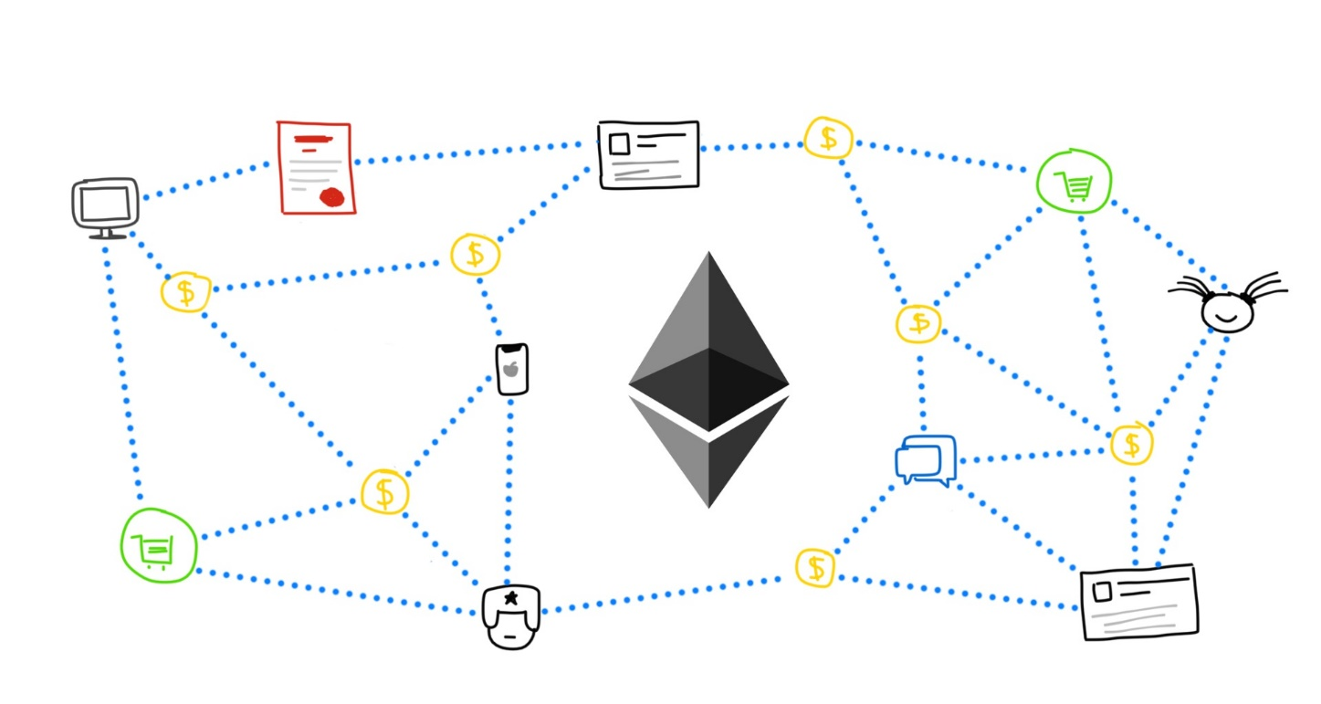
Ethereum, Smart Contracts
What is a Smart Contract? What is Solidity?

Slide 2

Table of Contents
What are Smart Contracts?
What is Solidity?

Slide 3
Ethereum

Slide 4
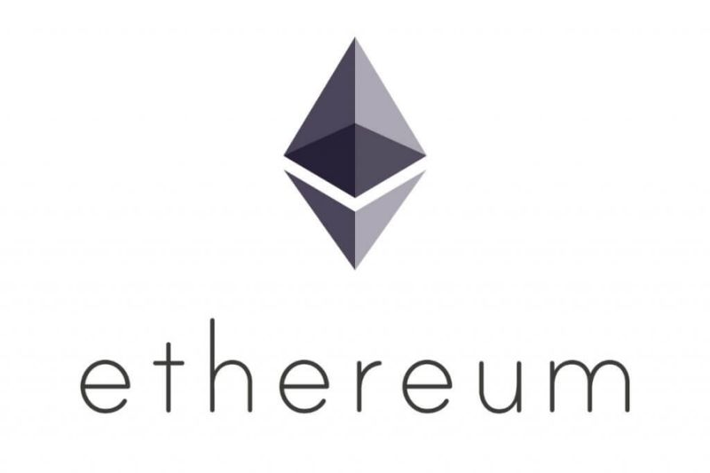
What is Ethereum?
Open software platform based upon Blockchain technology
Enables developers to build and deploy decentralized applications
The cryptocurrency is called Ether
Used to pay for transaction fees and services on the network

Slide 5
Smart Contracts

Slide 6

What are Smart Contracts?
Piece of code with rules followed by all participants in the network
Can be read from person and computer

Slide 7
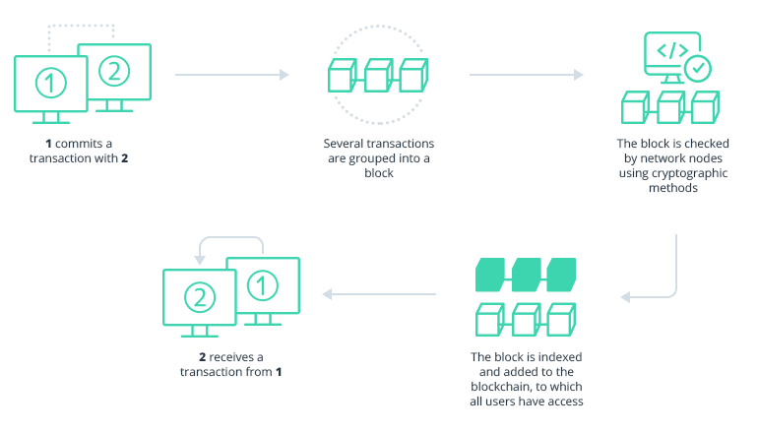

Slide 8
Solidity

Slide 9

What is Solidity?
Programming language for writing Smart Contracts in Ethereum network

Slide 10
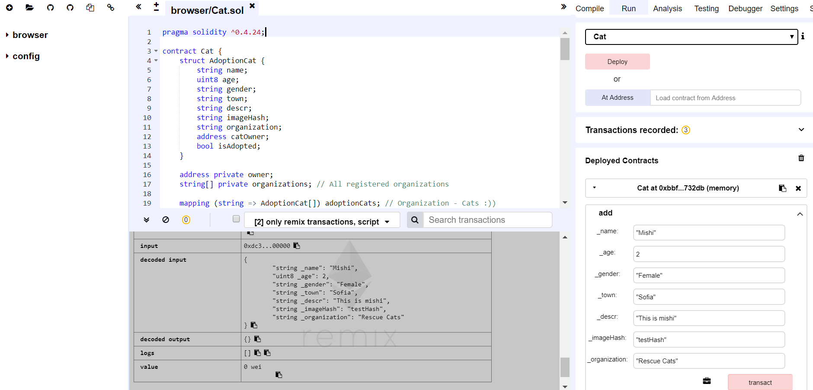
How looks Solidity?
https://github.com/mdamyanova/Blockchain-Basics-Mini-Course/blob/master/03.Ethereum%2C%20Smart%20Contracts/Demo/Cat.sol

Slide 11
Have a Question?
Ask in sli.do
#blockchain-mini

Slide 12

Summary
Ethereum
Open software platform based upon Blockchain technology for creating apps
Smart Contracts
Code with rules
Solidity
Programming language for writing smart contracts

